Slide 1
Topic: Simple Interest
EQ: How do I calculate simple interest?

Slide 2
Simple Interest
When you deposit money into a bank, the bank pays you interest.
When you borrow money from a bank, you pay interest to the bank.
Simple interest is money paid only on the principal.
Rate of interest is the percent charged or earned.
I = P  r  t
Time that the money is borrowed or invested (in years).
Principal is the amount of money borrowed or invested.

Slide 3
Converting
Move 2 places
to left & drop % sign
Change % to decimal
1) 12%
2) 5%
3) 2 ½ %
4) 8.5%
Change from decimal to % Answers
5) .098
6) .455
Answers
1) .12
2) .05
3) .025
4) .085
5) 9.8%
6) 45.5%
Move 2 places
to right & add % sign

Slide 4
Find the interest earned
Ray has $750 in a savings account that pays 3% simple interest. How much interest will he earn in 4 years?
I = 750 x 0.03 x 4
Ray will earn $90 interest in 4 years.

Slide 5
Find the interest paid
Cory borrows $1,200 from the bank for a riding lawn mower. The interest rate is 8% per year. How much simple interest will he pay if he takes 2 years to repay the loan?
I = 1,200 x 0.08% x 2
Cory will pay $192 interest in 2 years.

Slide 6
Find the interest earned.
Kate’s bank offered 4% simple interest on her deposit. She has $1,500 to invest. How much interest will she earn in 30 months?
30 months is how many years? 30/12 = 2.5 years
I = 1,500 x 4% x 2.5
Kate will earn $150 interest in 30 months.

Slide 7
Find the total paid
Henry charged $600 TV on his credit card with an interest rate of 21%. How much money will he owe after 9 months.
9 months is how many years? 9/12 = .75 years
I = 600 x 21% x .75
= $94.50 interest
Amount paid $600 + $94.50 = $694.50

Slide 8
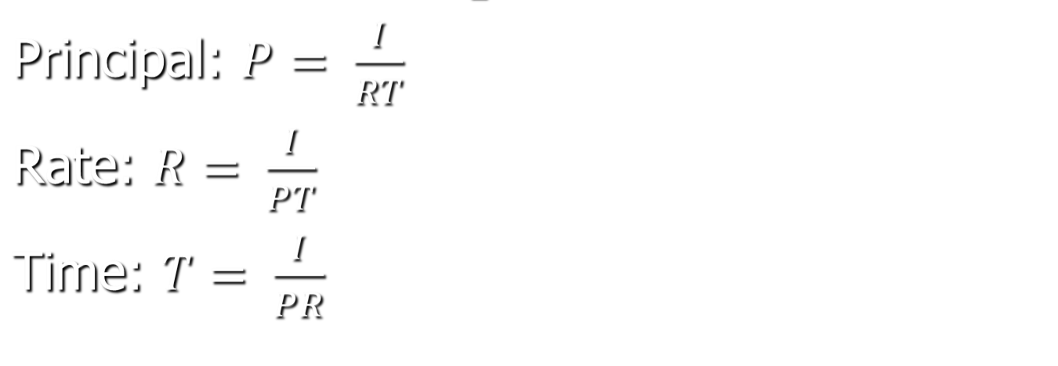
Other S.I. Formulas

Slide 9
Practice / Homework
Tuesday and Wednesday Week 1 Term 3
Exercise 11.1, 11.2, 11.3 pages 315-316 of textbook

